Slide 1
Bullet-Proof ASP.NET Core APIs: The OWASP API Security Top Ten
Christian Wenz
@chwenz
info@christianwenz.de

Slide 2
01
Broken Object Level Authorization

Slide 3
Broken Object Level Authorization
Guessed or stolen (GU)IDs
Mitigation: permission checks, no exceptions!

Slide 4
02
Broken Authentication

Slide 5
Broken Authentication
Buggy JWT validation:
- No signature
- Audience not validated
- Issuer not validated
- Expiration date not validated
Food for thought: https://blog.ploetzli.ch/2024/should-i-use-jwt-for-authentication/

Slide 6

Demo: Brute-Forcing JWTs
Christian Wenz

Slide 7
03
Broken Object Property Level Authorization

Slide 8
Broken Object Property Level Authorization
Mass assignment/overposting

Slide 9
Demo: Mass Assignment
Christian Wenz

Slide 10
04
Unrestricted Resource Consumption

Slide 11
Unrestricted Resource Consumption
Rate limiting (if feasible)
GraphQL: several queries in one, page size

Slide 12
Demo: GraphQL Injection
Christian Wenz

Slide 13
05
Broken Function Level Authorization

Slide 14
Broken Function Level Authorization
Require authorization for all HTTP methods

Slide 15
06
Unrestricted Access to Sensitive Business Flows

Slide 16
Unrestricted Access to Sensitive Business Flows
Technical countermeasures (e.g. parameter validation)
Processual countermeasures (e.g. deleting duplicate bookings)

Slide 17
07
Server-Side Request Forgery

Slide 18
Server-Side Request Forgery
1) Sends request
2) Sends request
Client
Victim (server)
Actual victim (server)

Slide 19
08
Security Misconfiguration

Slide 20
Security Misconfiguration
Security HTTP headers
Revealing HTTP headers

Slide 21
09
Improper Inventory Management

Slide 22
Improper Inventory Management
„Forgotten“ test servers
Inventory for servers, assets, API versions, …

Slide 23
10
Unsafe Consumption of APIs

Slide 24
Unsafe Consumption of APIs
Third-party APIs are as „trustworthy“ as client requests

Slide 25

Get .NET 9
Download .NET 9 aka.ms/get-dotnet-9

Slide 26
Resources
https://owasp.org/API-Security/
https://www.manning.com/books/asp-net-core-security
OWASP API Security Top 10
Image source: “ASP.NET Core Security” (Manning Publications)

Slide 27
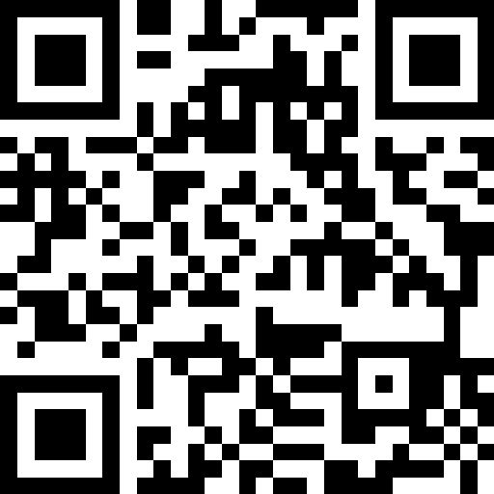
Thank you

